Slide 1
ChatGPT and Other AI Tools for Medicine and Medical Education
William Hersh, MD
Professor
Department of Medical Informatics & Clinical Epidemiology
Oregon Health & Science University
Portland, OR, USA

Slide 2
Overview
Brief introduction of AI tools that medical students (health professions learners) can use including ChatGPT
Applying ChatGPT and other AI tools to learning in medical education/health professions education
Academic misconduct and other risks of ChatGPT and AI tools
Future directions for ChatGPT and other AI tools

Slide 3
1. Introduction – artificial intelligence (AI)
AI – “information systems and algorithms capable of performing tasks associated with human intelligence” (Rajpurkar, 2022; Sahni, 2023)
Predictive AI – use of data and algorithms to predict some output (e.g., diagnosis, treatment recommendation, prognosis, etc.)
Generative AI – generates new output based on prompts (e.g., text, images, etc.)
A large part of modern success of AI due to machine learning – “computer programs that learn without being explicitly programmed” (McCarthy, 1990, attributed to Samuel, 1959; Shah, 2023)
Most success with deep learning, based on many-layered neural networks

Slide 4
AI is not new – first era in mid-20th century
Earliest paper related to AI and biomedical informatics attributed to Ledley and Lusted (1959) aiming to model physician reasoning through symbolic logic and probability
Warner (1961) developed mathematical model for diagnosing congenital heart disease
In 1960s-1970s, emergence of “expert systems” – computer programs aiming to mimic human expertise (historical overview – Lea, 2023)
Rule-based systems – PhD dissertation of Shortliffe (1975) and subsequent work (Clancey, 1984)
Disease profiles and scoring algorithms – INTERNIST-1 (Miller, 1982) and DxPlain (Barnett, 1987)
Limited by approach of manual construction and maintenance of knowledge
Not scalable or sustainable
Led to “AI winter” between 1990-2010
Main remnant is clinical decision support (CDS) for electronic health records (EHRs) that emerged in 1990s for electronic health records (Greenes, 2023)

Slide 5
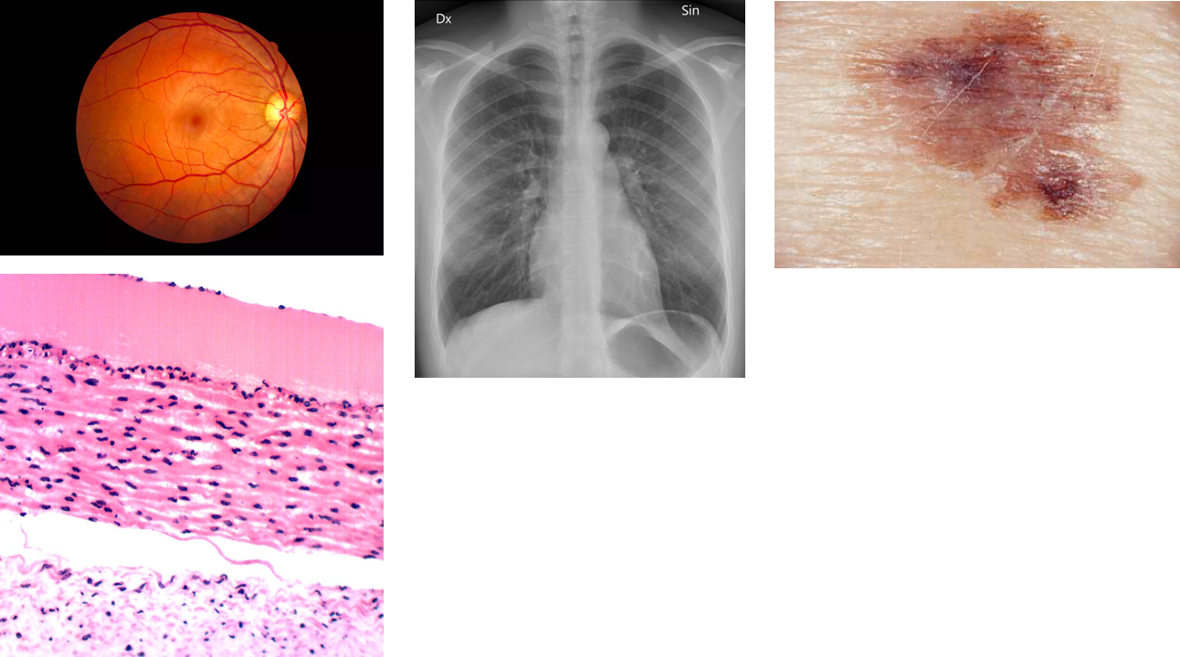
Re-emergence of AI in 21st century
“Predictive AI” driven by advances in machine learning, increasing availability of data, and more powerful computers and networks (Topol, 2019; Rajpurkar, 2022)
Deep learning in imaging advanced by Hinton (2006)
Most success in image interpretation (Rajpurkar, 2023); examples include
Radiology – chest x-rays for diagnosis of pneumonia and tuberculosis
Ophthalmology – retinal images for diagnosis of diabetic retinopathy
Dermatology – skin lesions for diagnosis of cancer
Pathology – breast cancer slides to predict metastasis

Slide 6
Predictive AI not limited to imaging
Adverse events in hospitalizations from EHR data (Rajkomar, 2018)
Generating clinical notes from patient and physician verbal interaction (Rajkomar, 2019)
Protein folding from amino acid sequences (Jumper, 2021)
Next-generation sequencing (NGS) data on >36K tumors able to predict cancer of unknown primary with high confidence for 41% of tumors, leading to improved survival for those patients (Moon, 2023)
ML model based on past ICD-10 codes and lab results to predict future diagnoses in office visits (Mukherjee, 2023)
Semantic reconstruction of continuous language from fMRI brain recordings (Tang, 2023)
Map chemicals to odors perceived by humans (Lee, 2023)

Slide 7
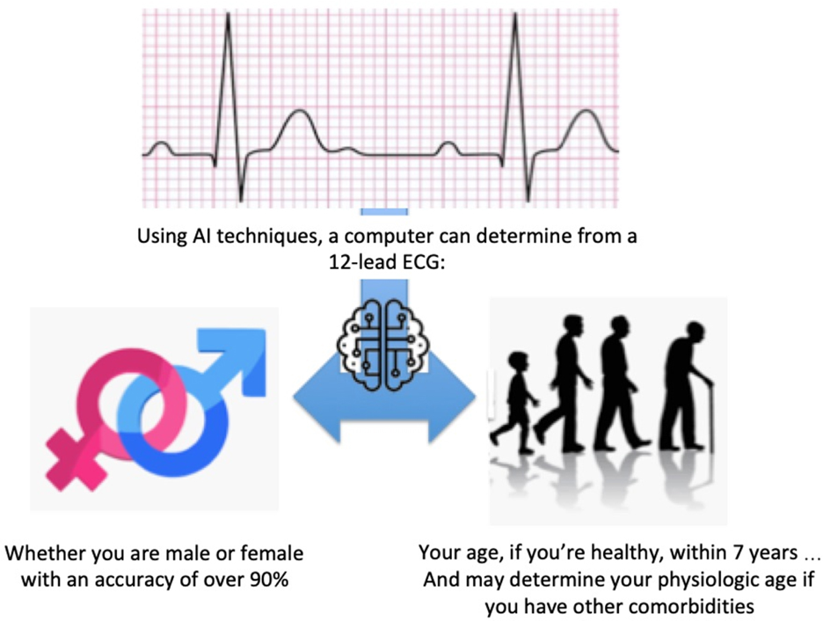
Also success in “seeing” where humans cannot (Topol, 2023)
Retinal images
Age, biological sex, and cardiovascular risk determination from retinal images (Poplin, 2018)
Race (Coyner, 2023)
Electrocardiograms (ECGs)
Age and biological sex determination (Attia, 2019)
Diagnosis and risk stratification in occlusive myocardial infarction (Al-Zaiti, 2023)
Chronic kidney disease (Holmstrom, 2023)
Left ventricular systolic dysfunction from ECG images (Sangha, 2023)
Chest x-rays
Race (Gichoya, 2022)
Cardiac function and valvular heart diseases (Ueda, 2023)
Diabetes (Pyrros, 2023)
Correlation with chronological age in healthy cohorts and, for various chronic diseases, difference between estimated age and chronological age (Mitsuyama, 2023)

Slide 8
And now, “generative AI”
Introduction of ChatGPT in November, 2022 brought new type of AI into focus: generative AI
Initially based on GPT-3.5 model; added larger GPT-4 soon after
Based on large language models (LLMs) processed by deep neural networks using large amounts of training data and tuned for specific tasks
Trained on massive amounts of text and other content, e.g., large Web crawls, books, Wikipedia, and more for ChatGPT (Roberts, 2022)
Use transformer models that predict words in sequence from billions/trillions of words and add measure of importance to “attention” words (Raschka, 2023)
Fine-tuned for specific tasks (Chung, 2022)
Activated by (and importance of) prompting (Liu, 2023)

Slide 9
Results of ChatGPT and other LLMs
Medical board exams
USMLE “arms race,” starting with (Kung, 2023)
Claimed best – https://www.openevidence.com/blog/openevidence-ai-first-ai-score-above-90-percent-on-the-usmle
Even on “soft skills” (e.g., communication skills, ethics, empathy, and professionalism) questions (Brin, 2023)
Passing level on some board exams (clinical informatics – Kumah-Crystal, 2023; radiology – Bhayana, 2023) but not others (neonatology – Beam, 2023)
Answering questions
Vary by subject domain and type, but sometimes wrong and/or incomplete (e.g., Antaki, 2023; Chen, 2023)
Solving clinical cases
Comparable to but not better than expert humans (e.g., Levine, 2023; Kanjee, 2023; Rao, 2023; Benoit, 2023; Goodman, 2023)
Communicating with patients
Answer questions in public forums and write letters with comparable or better empathy (Sarraju, 2023; Ali, 2023, Ayers, 2023)

Slide 10
2. Applying ChatGPT and other AI tools
It’s already here
ChatGPT in medical education
Tools for predictive AI

Slide 11
Generative AI in education – it’s already here
“My class required AI. Here's what I've learned so far.” (Mollick, 2023)
“I’m a student. You have no idea how much we’re using ChatGPT. No professor or software could ever pick up on it.” (Terry, 2023)
“The end of the take-home essay? How ChatGPT changed my plans for the fall.” (Robin, 2023)
“Here’s my AI policy for students: I don’t have one.” (Zimmerman, 2023)
“ChatGPT has transformed the problem of grade inflation from a minor corruption to an enterprise-destroying blight.” (Clune, 2023)

Slide 12
Benefits of ChatGPT for faculty
Tasks for students (Mollick, 2022)
Benefits for faculty (Mollick, 2023)
Improving transfer of knowledge
Apply concept(s) to new situations
Critique output as right or wrong
Teaching how to evaluate
Assess and improve output
Break illusion of explanatory depth
Explain steps of a concept
Providing multiple examples and explanations
Uncovering and addressing student misconceptions
Frequent low-stakes testing
Assessing student learning
Distributed practice of important ideas over time

Slide 13
ChatGPT will change education, not destroy it (Heaven, 2023)
Assessment already broken: “if ChatGPT makes it easy to cheat on an assignment, teachers should throw out the assignment rather than ban the chatbot”
Change focus: use ChatGPT to generate an argument and then annotate it according to how effective argument was for a specific audience; then turn in rewrite based on their criticism
Overcome misinformation and bias: ask students to use ChatGPT to generate text on a topic and then point out flaws
Interact with ChatGPT to debate and generate counterarguments

Slide 14
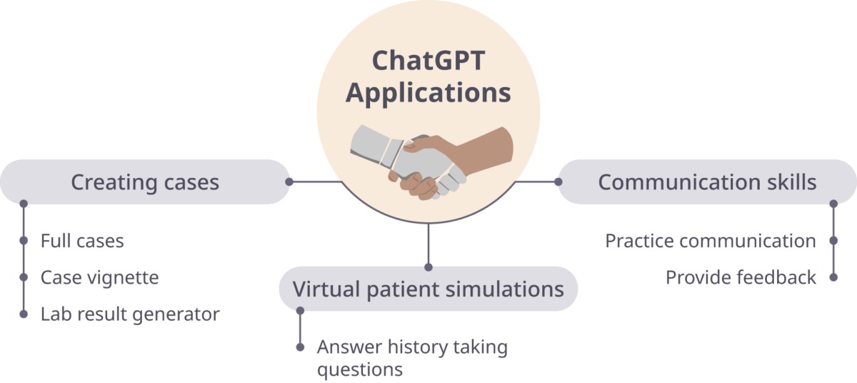
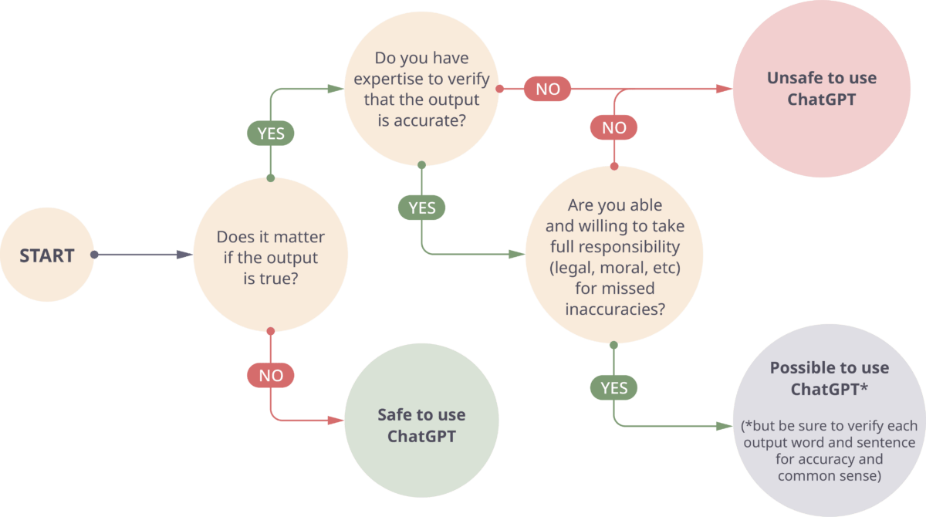
ChatGPT in medical education (Ratliff, 2023)

Slide 15
Prompt engineering in medical education (Heston, 2023)
Best practices
Uses and concerns
Structure with context, general request, how the generative AI is to act, and output format
Utilize iterative prompts
Avoid vague, misleading, and inappropriate prompts
Mathematical, logical, and academic citation prompts can be challenging
Use for
Summarizing material
Generating frequently asked questions (FAQs)
Creating test questions
What constitutes cheating?
Use of generative AI instead of thinking and synthesizing?
Use to improve grammar or readability?
Best approach to incorporate rather than prohibit?

Slide 16
Other uses of ChatGPT
Developing patient handouts in rural dermatology (Baker, 2023)
Creating medical art (Huston, 2023)
Using ChatGPT in medical practice (Bair, 2023)
Create checklists for common presentations
Plugins to access management guidelines and literature pertaining to patient-specific issues
BrowserPilot allows access to live websites in real-time
ScholarAI allows search for peer-reviewed articles on PubMed and other research databases
Generating templates for common clinical scenarios

Slide 17
Let’s not forget about tools for predictive AI
Data sets – no single repository (e.g., PubMed) but easy to find by searching (why you need that competency), e.g.,
Linked to papers using data sets
Kaggle challenges
https://www.kaggle.com/datasets?search=biomedical
Papers With Code
https://paperswithcode.com/datasets?mod=medical
Tools – age-old question: Should physicians be programmers?
Programming tools in Python and R
No-code (visual) programming tools (Hirzel, 2023)

Slide 18
No-code programming – Orange data mining
“No-code” model development – visual programming package
https://orangedatamining.com/
https://orangedatamining.com/download/
Written in Python and extensible
Excellent series of introductory YouTube videos
https://www.youtube.com/@OrangeDataMining
NoCode Data Science (Bob Hoyt and David Patrishkoff)
https://www.nocodedatascience.net/

Slide 19
Functionality in Orange
Comes with small data sets but you can add your own
Tools for data exploration, visualization, and modeling, including
Predictive models
Classification
Regression
Image classification
Text mining

Slide 20
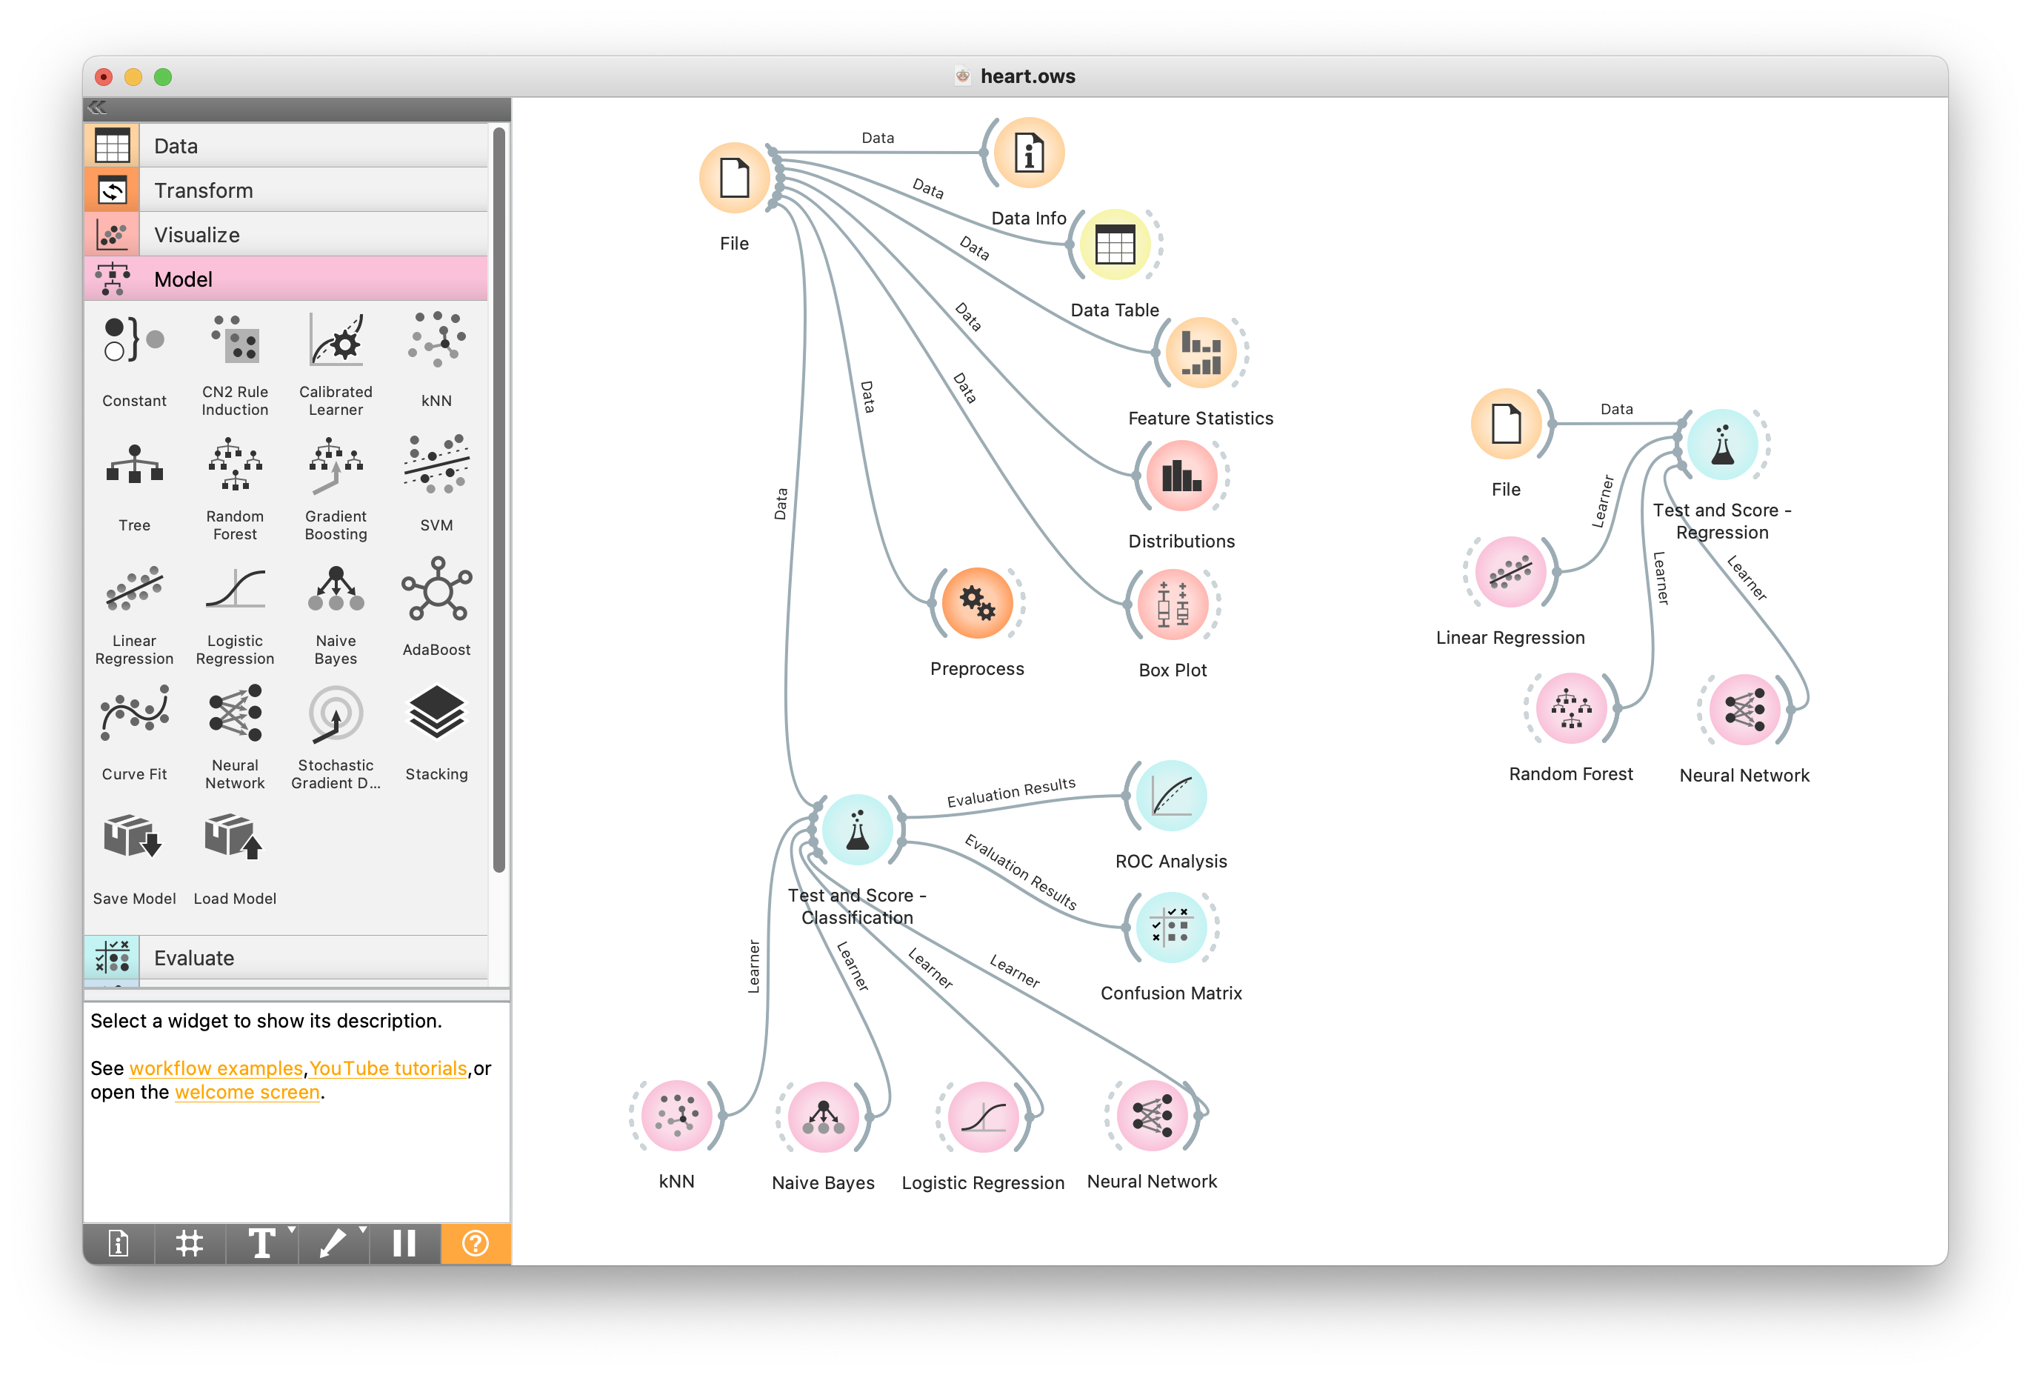
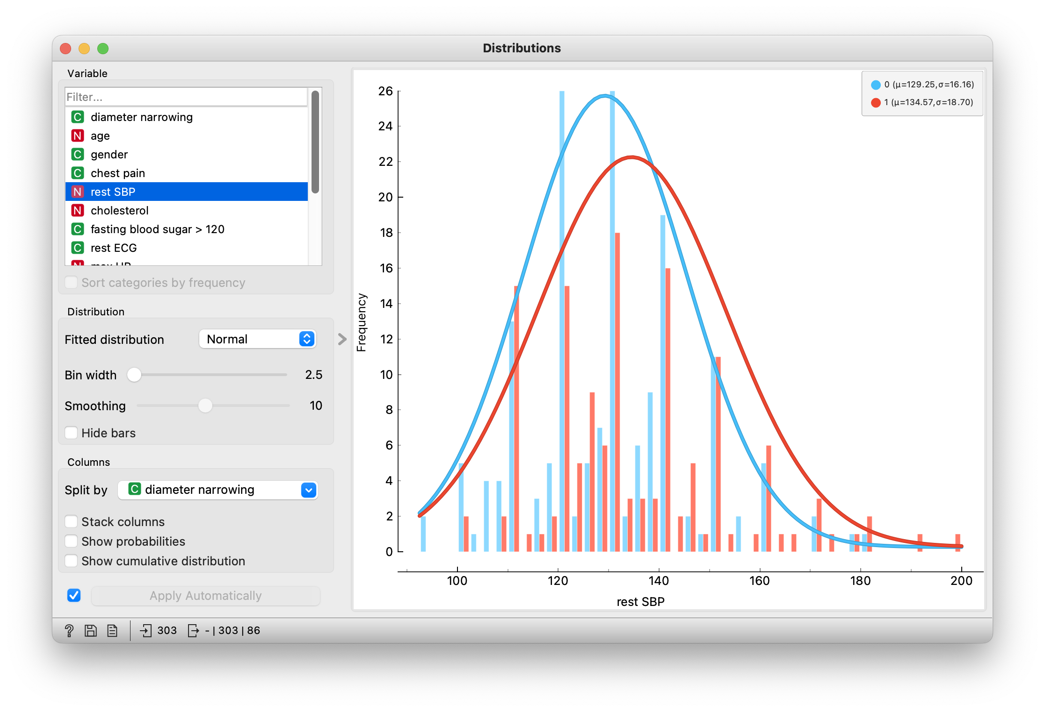
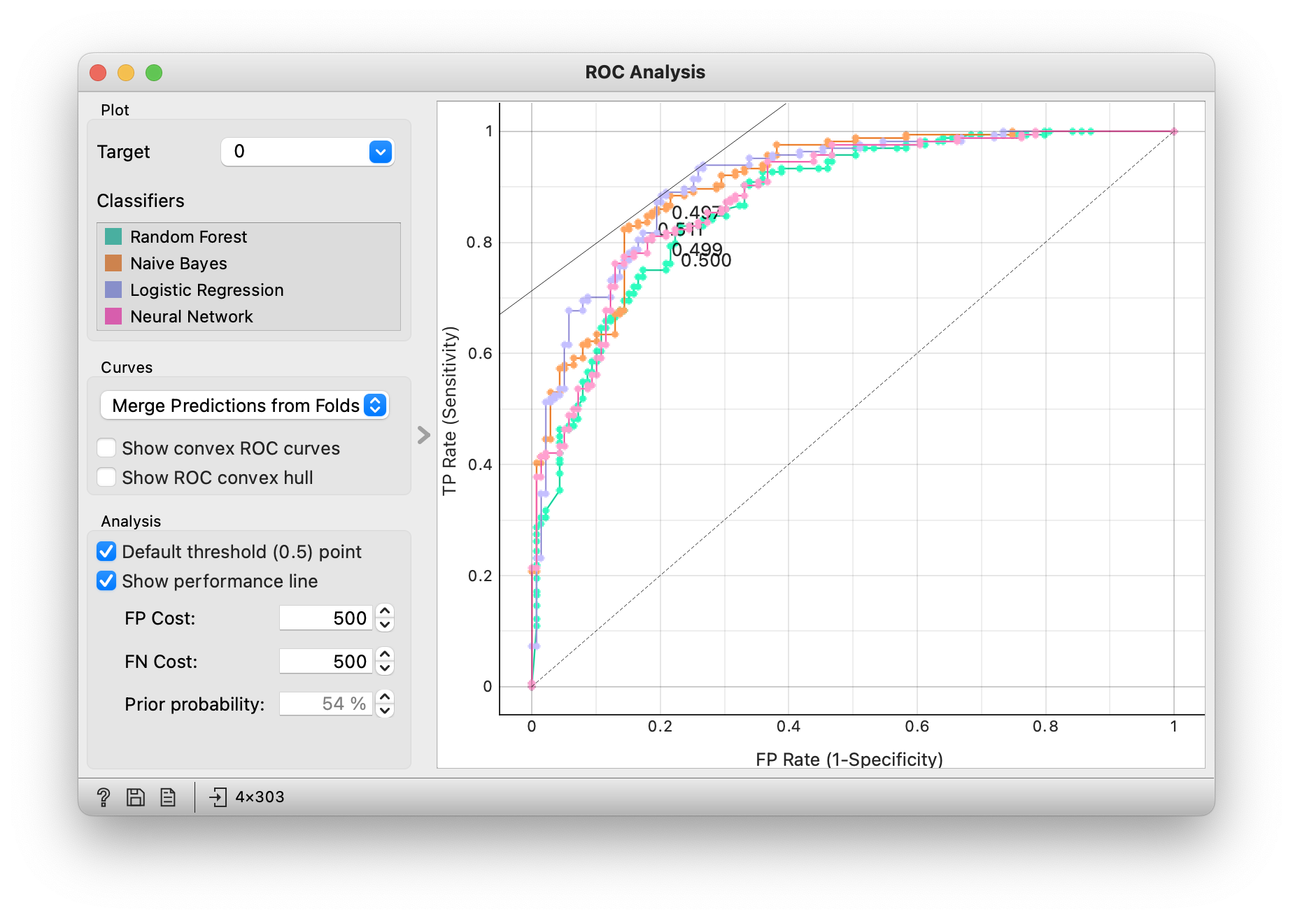
Visual programming, exploration, and modeling in Orange

Slide 21
What is impact of AI in medicine to date?
Real-world use and evidence base still modest – systematic reviews of clinical trials of predictive AI systems (Zhou, 2021; Plana, 2022; Han, 2023) show
Small numbers of trials – especially relative to predictive model papers)
Mediocre methodologies including risk of bias
Mix of positive/negative results
“AI won’t replace radiologists, but radiologists who use AI will replace radiologists who don’t,” (Langlotz, 2019)
Must address bias in data and algorithms
AI may compromise care if not used properly (DeCamp, 2023)
Must be implemented in responsible (Dorr, 2023) and fair (Chen, 2023) ways

Slide 22
3. Academic misconduct and other risks of ChatGPT
Downsides to ChatGPT and other LLMs
Balancing benefits and risks

Slide 23
Downsides to ChatGPT and other LLMs
Equally compelling disinformation – humans cannot distinguish between true and false tweets generated by GPT-3 and written by real Twitter users (Spitale, 2023)
Fabrication and errors in the bibliographic citations – asked to produce short literature reviews on 42 multidisciplinary topics (Walters, 2023)
55% of GPT-3.5 citations and 18% of GPT-4 citations fabricated
43% of real (non-fabricated) GPT-3.5 citations and 24% of real GPT-4 citations include substantive errors
8 dermatology questions asked of 4 LLMs recapitulated “harmful, race-based medicine” (Omiye, 2023)
Performs worse than humans in abstraction and analogy problems (Moskvichev, 2023)
GPT detectors more likely to classify non-native English writing as AI-generated (Liang, 2023)

Slide 24
ChatGPT benefits and risks in education (Sok, 2023)
Benefits
Risks
Creating learning assessment
Enhancing pedagogical practice
Offering virtual personal tutoring
Creating an outline
Brainstorming ideas
Academic integrity issues
Unfair learning assessment
Inaccurate information
Over-reliance on AI

Slide 25
Recommendations for medical faculty and institutions (Boscardin, 2023)
Educators
Institutions
Increase AI knowledge
Understand the current landscape of AI use in medical education
Review strategies for successful AI integration into education
Become stewards of ethical use of AI
Review and revise school policies (and create new policies as needed) regarding use of generative AI
Support faculty development about AI and provide resources for teaching
Offer information-checking tools for originality and plagiarism to faculty

Slide 26
Strategies for responsible use of ChatGPT in education (Halaweh, 2023)
Explicit policy in course syllabi or assessments
Student reflection
Audit trail of queries
Use AI detector tools
Swap student and instructor roles in use

Slide 27
4. Future directions for ChatGPT and other AI tools
Where do ChatGPT and other AI tools fit in medical education?
What competencies should medical students have in AI and larger biomedical and health informatics?
How can we prepare students for practice in a future of Big Data, algorithms, and AI?

Slide 28
Where do ChatGPT and other AI tools fit in medicine?
Biomedicine and Health
Biomedical and Health Informatics
AI – Predictive and Generative
ChatGPT and Generative AI

Slide 29
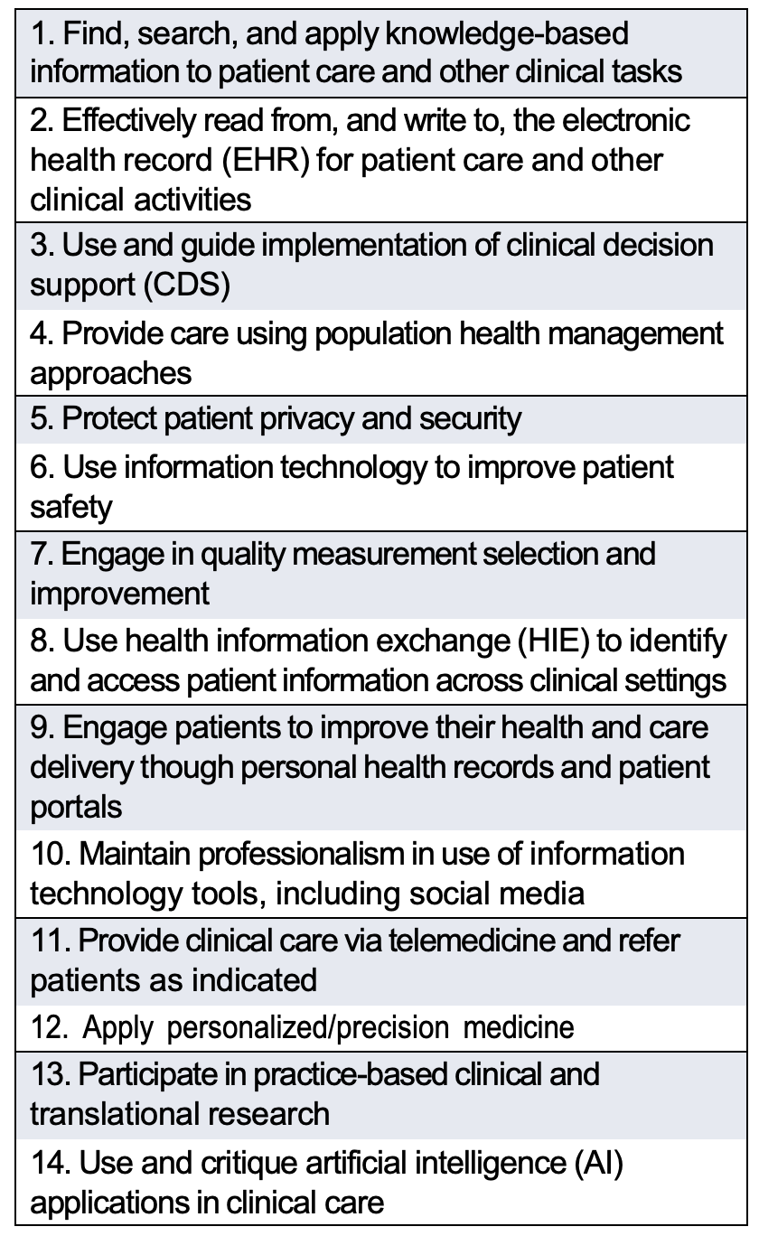
AI and health professions education
Mostly physician-based but applies to all health professions
Before generative AI there was recognition of need for competencies in clinical informatics for medical education (Hersh, 2014; Hersh 2020; Hersh, 2023)
Others noted
AI should be taught as a “fundamental toolset” (Ötleş, 2022)
Clinicians must be prepared to practice in a world of AI (James, 2022)
Medical schools face dual challenges of needing to teach about AI in practice but also adapt to its use by learners and faculty (Cooper, 2023)
New AI-competency frameworks
Use of AI-based tools by healthcare professionals (Russell, 2023; Liaw, 2023; Seth, 2023)
We must prepare physicians for the “clinical algorithm era” (Goodman, 2023)

Slide 30
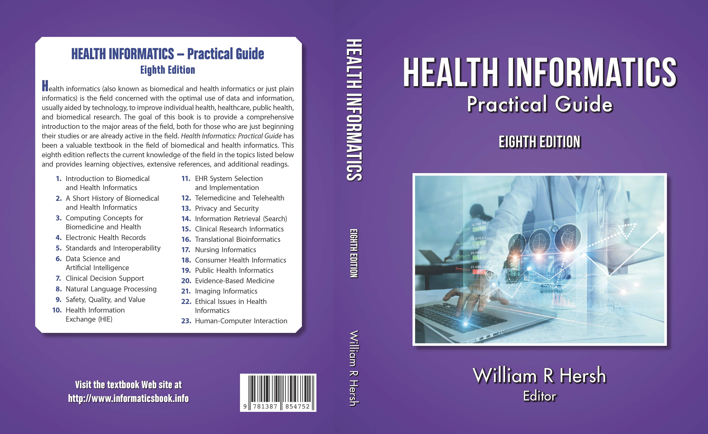
There are many additional topics to master in health/clinical informatics (Hersh, 2022)

Slide 31
Competencies for use of AI-based tools by healthcare professionals (Russell, 2023)
Domains | Details
Basic knowledge of AI | Explain what AI is and describe its healthcare applications
Social and ethical implications of AI | Explain how social, economic, and political systems influence AI-based tools and how these relationships impact justice, equity, and ethics
AI-enhanced clinical encounters | Carry out AI-enhanced clinical encounters that integrate diverse sources of information in creating patient-centered care plans
Evidence-based evaluation of AI-based tools | Evaluate the quality, accuracy, safety, contextual appropriateness, and biases of AI-based tools and their underlying datasets in providing care to patients and populations
Workflow analysis for AI-based tools | Analyze and adapt to changes in teams, roles, responsibilities, and workflows resulting from implementation of AI-based tools
Practice-based learning and improvement regarding AI-based tools | Participate in continuing professional development and practice-based improvement activities related to use of AI tools in healthcare

Slide 32
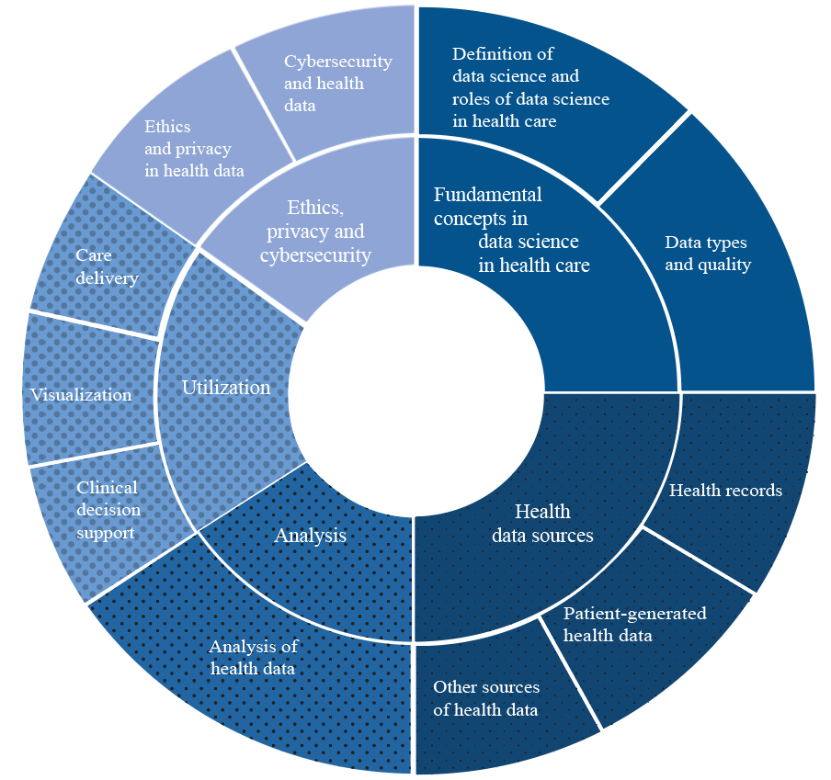
Core competencies in data science for medical education in age of AI in healthcare (Seth, 2023)
Fundamental concepts in data science in health care
Definition of data science and roles of data science in health care
Data types and quality
Health data sources
Health records
Patient-generated health data
Other sources of health data
Analysis
Analysis of health data
Usage
Visualization
Care delivery
Clinical decision support
Ethics, privacy, and cybersecurity
Ethics and privacy in health data
Cybersecurity and health data

Slide 33
Preparing physicians for the “clinical algorithm era” (Goodman, 2023)
Preclinical medical education
Clinical training
Teach probability in medical school using intuitive, modern approaches
Teach probabilistic clinical reasoning
Assess probability and probabilistic reasoning skills
Teach core, foundational working knowledge of CDS and EHR implementation, relevant to clinical use
Practice interpreting CDS output in applied learning
Reinforce probabilistic training and application
Build CDS interpretation into curricula
Reinforce working knowledge of CDS and EHR implementation, relevant to clinical use
Include working knowledge of CDS in ACGME core competencies

Slide 34
Conclusions
Predictive and generative AI will profoundly impact the practice and education of all health professions
Day-to-day impact, especially in clinical settings, small so far but likely to grow
Need real-world implementation and evaluation for safety and efficacy just like all other clinical interventions
Clinical and informatics professionals must be able to understand, implement, and critique applications of AI in their work and in healthcare more broadly
Health professions educators must adapt to generative AI for writing, examination, and other pedagogic tasks

Slide 35
Questions?
William Hersh, M.D.
Professor
Department of Medical Informatics & Clinical Epidemiology
Oregon Health & Science University
Portland, OR, USA
Email: hersh@ohsu.edu
Web: http://www.billhersh.info
Blog: https://informaticsprofessor.blogspot.com/
Also on
Facebook
LinkedIn
Twitter – @williamhersh

